Slide 1

LANGURU APP
SPRING 2023 - CS 691- CAPSTONE PROJECT
PROFESSOR HENRY WONG
PACE UNIVERSITY

Slide 2
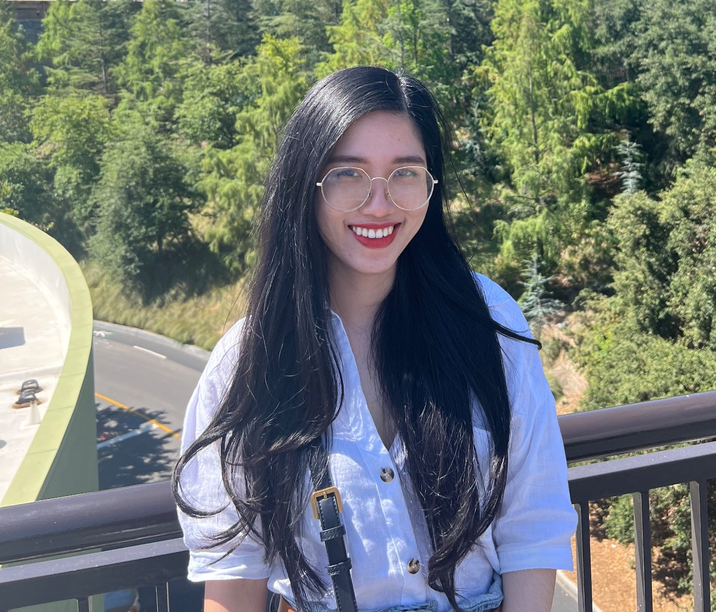

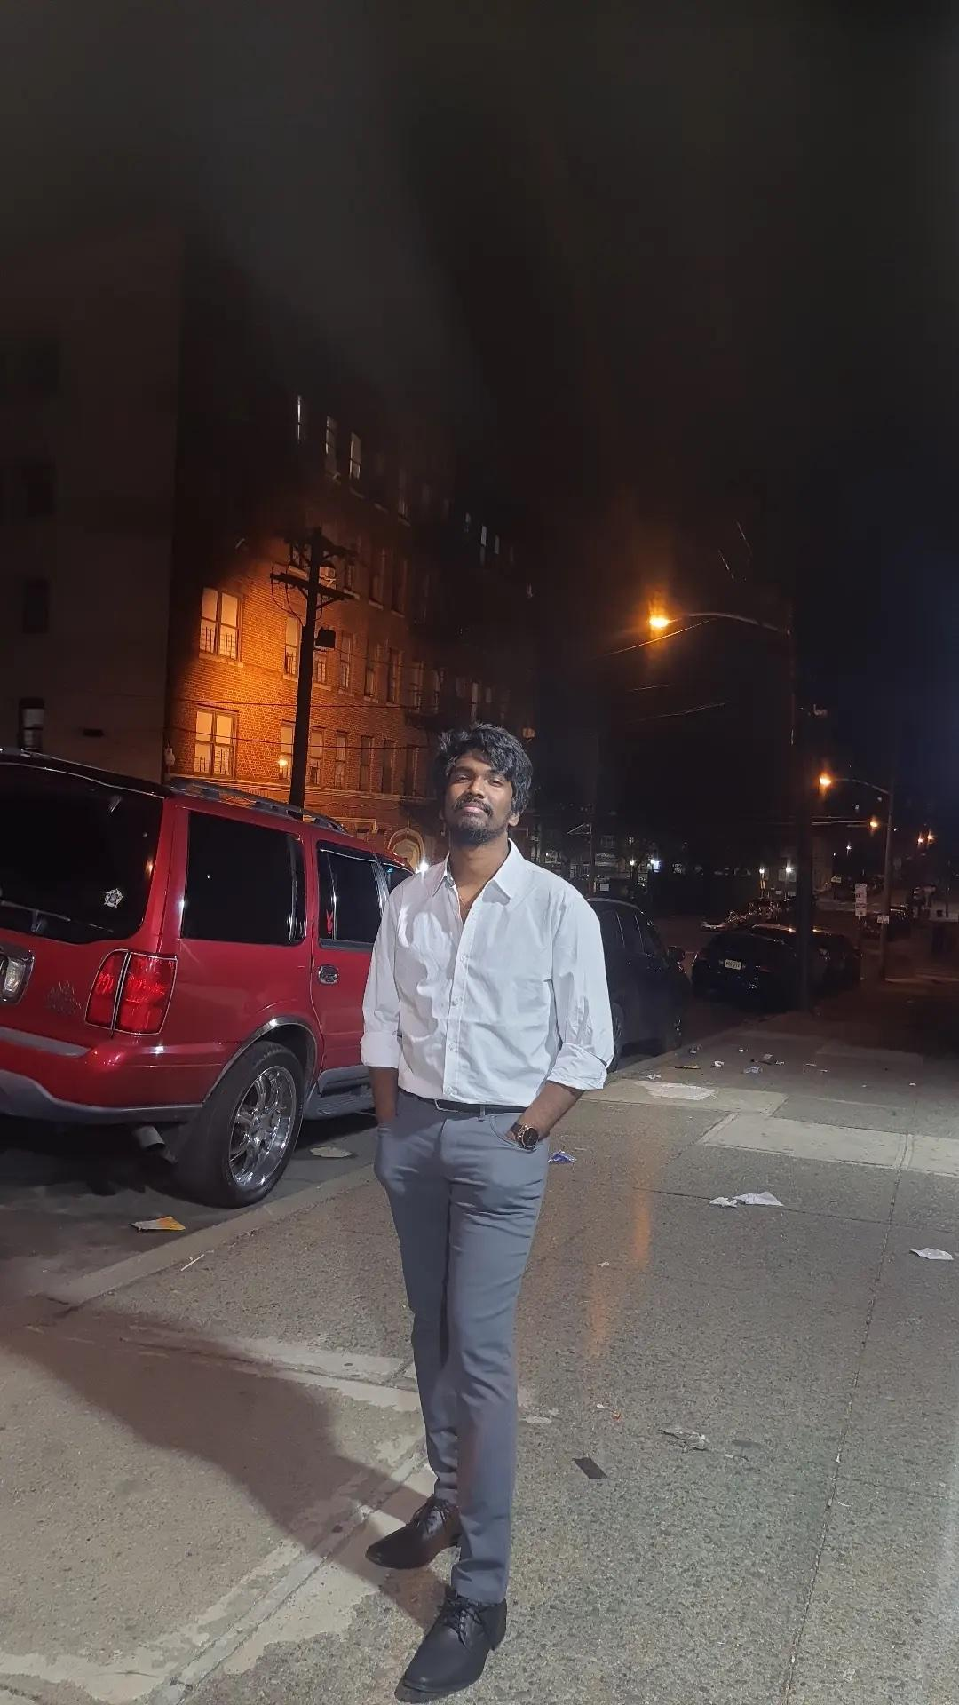
OUR TEAM
Thanh (Kate) Pham
Musa Nishat
Noel Sam Routhu
Developer,
Scrum Master
Developer
Database Administrator

Slide 3
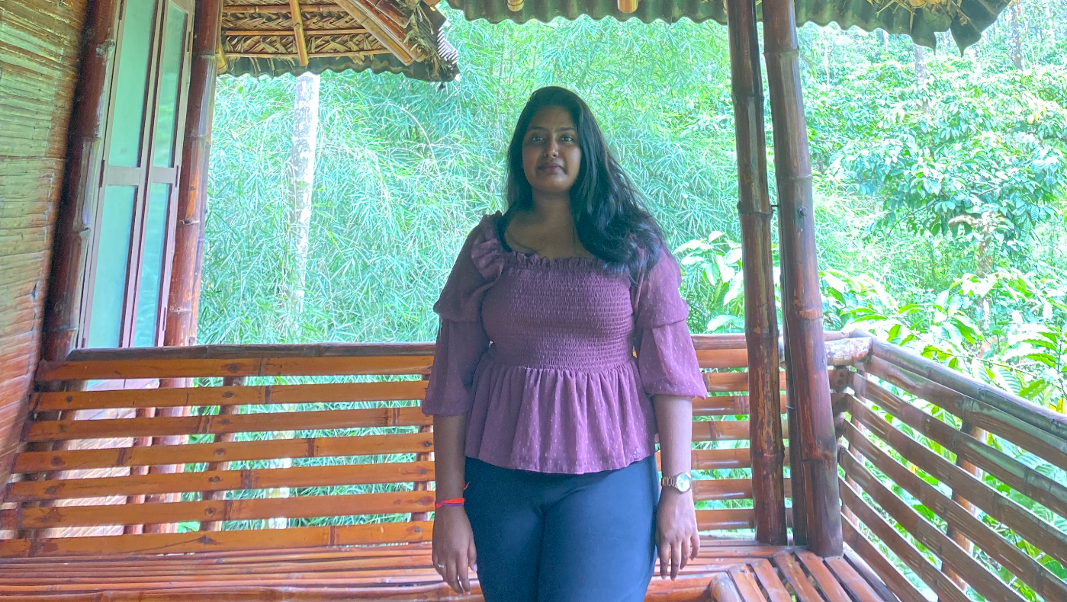
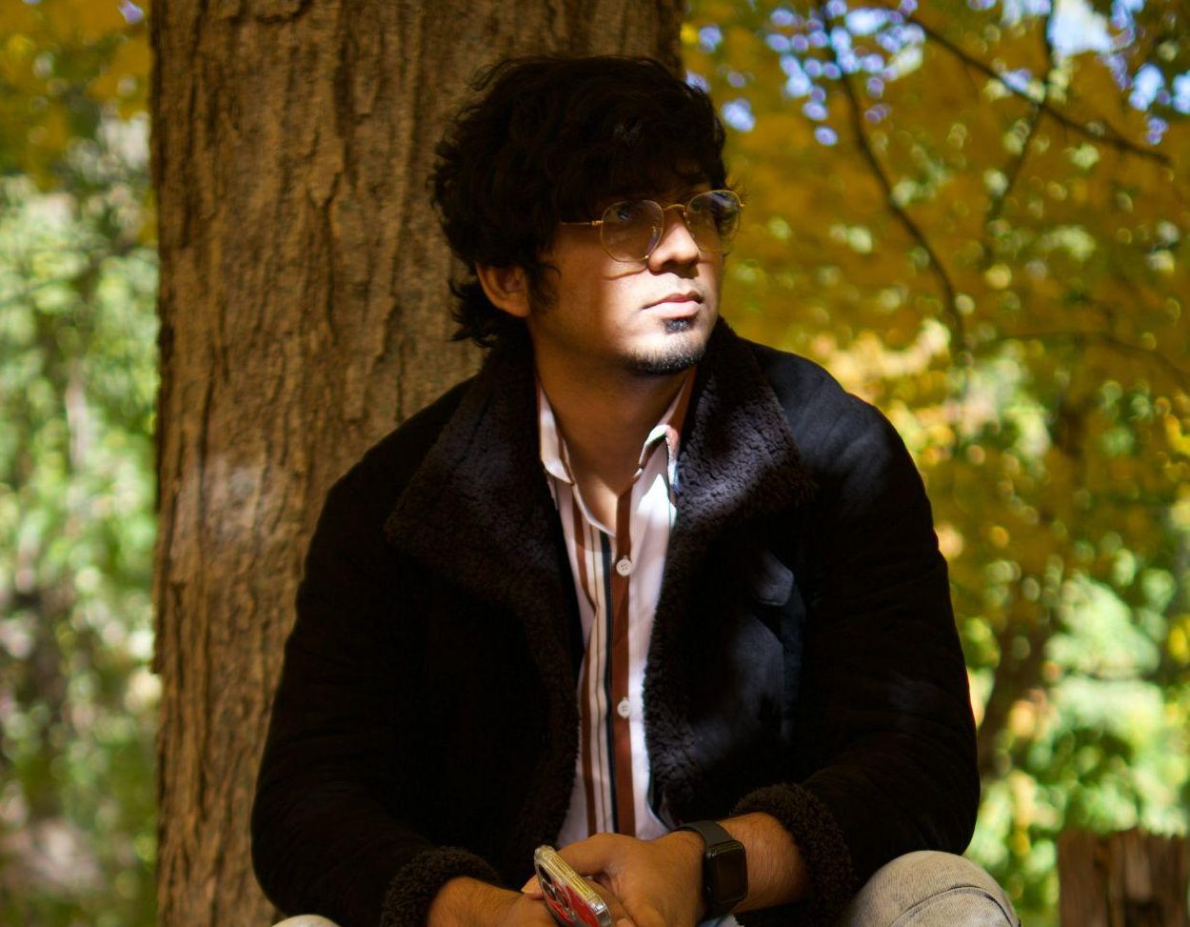
MEET OUR TEAM
Indeevara Tadikonda
Hariharammurthy Krishnamoorthy
Developer
Quality Analyst And Tester

Slide 4
AGENDA
1. Improvement from Professor’s Feedback. | 8. Product Backlog and Sprint Backlog
2. Problem Statement vs Solution | 9. Metrics
3. Personas | 10. Retrospective
4. Minimum Viable Product | 11. Sprint 4
5. Technologies | 12. Product Demo Sprint 3
6. Architecture Diagrams | 13. Live Application Demo
7. Sprint 2 Recap

Slide 5
Professor’s feedback and Improvement
01
The team was missing the API slide
→ will add it at Sprint 4
Stories points are always in the Fibonacci series → Changed stories points to Fibonacci series.
The team must create tables in slides instead of using screenshots → Changed
The team is missing the burndown chart → Burndown chart was added in this Sprint.
Late submission

Slide 6
02
PROBLEM VS. SOLUTION

Slide 7
PROBLEM STATEMENT
English learners faces challenges when they speak E.L correctly due to limited feedback on their speech while English teachers’ feedback is costly and time consuming.
The current speech recognition technology is not accurate enough to provide reliable feedback on pronunciation, which can hinder the learning process.

Slide 8
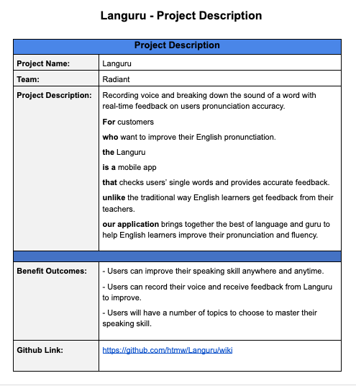
PROJECT
DESCRIPTION

Slide 9
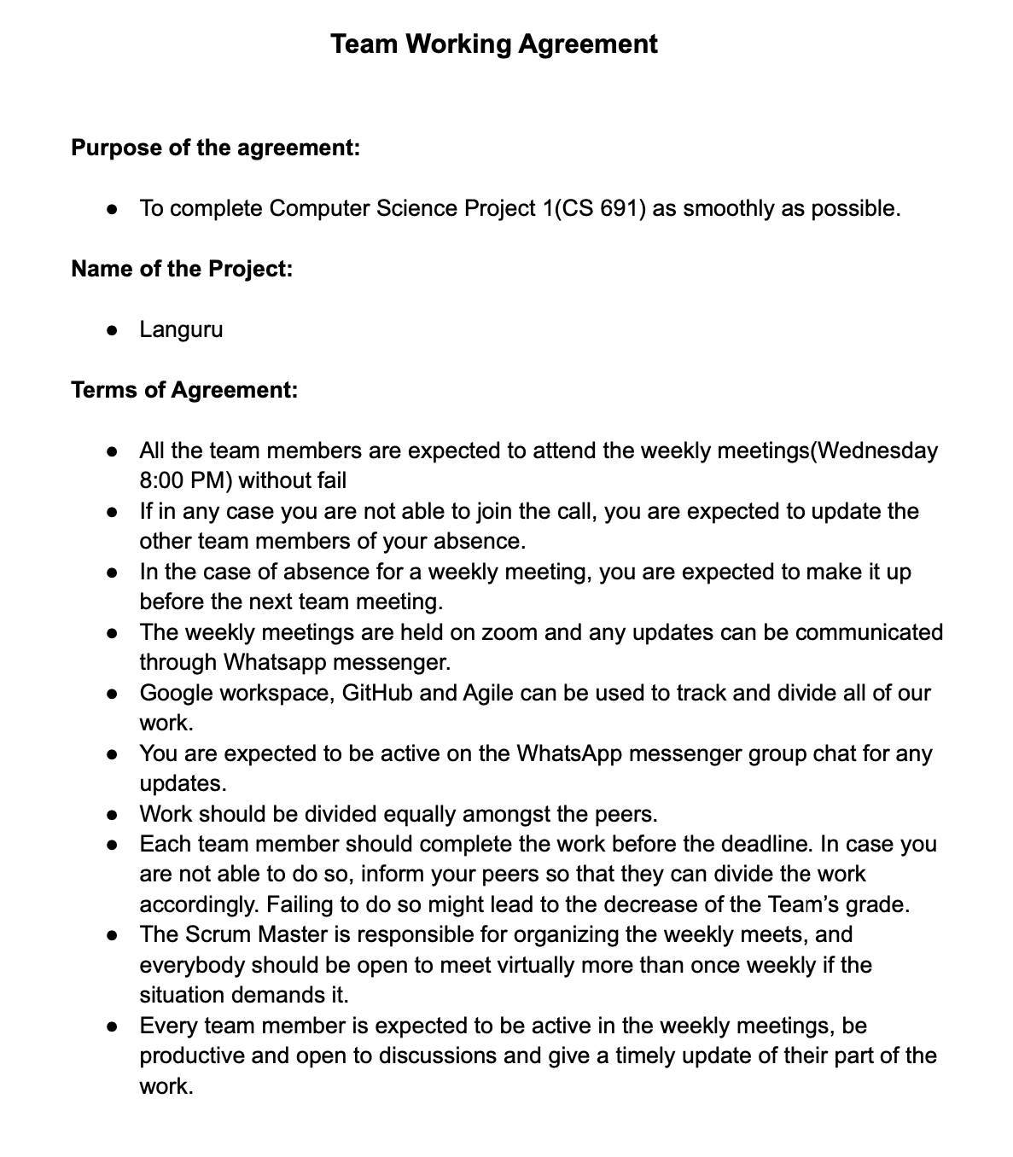
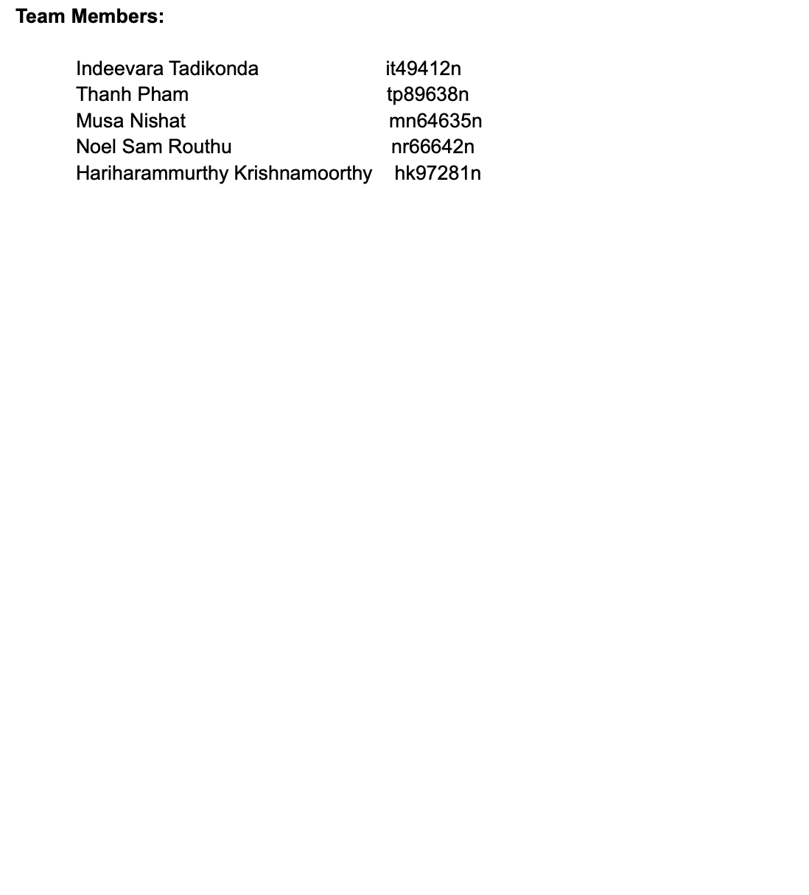
Team Working Agreement

Slide 10
03
PERSONAS

Slide 11
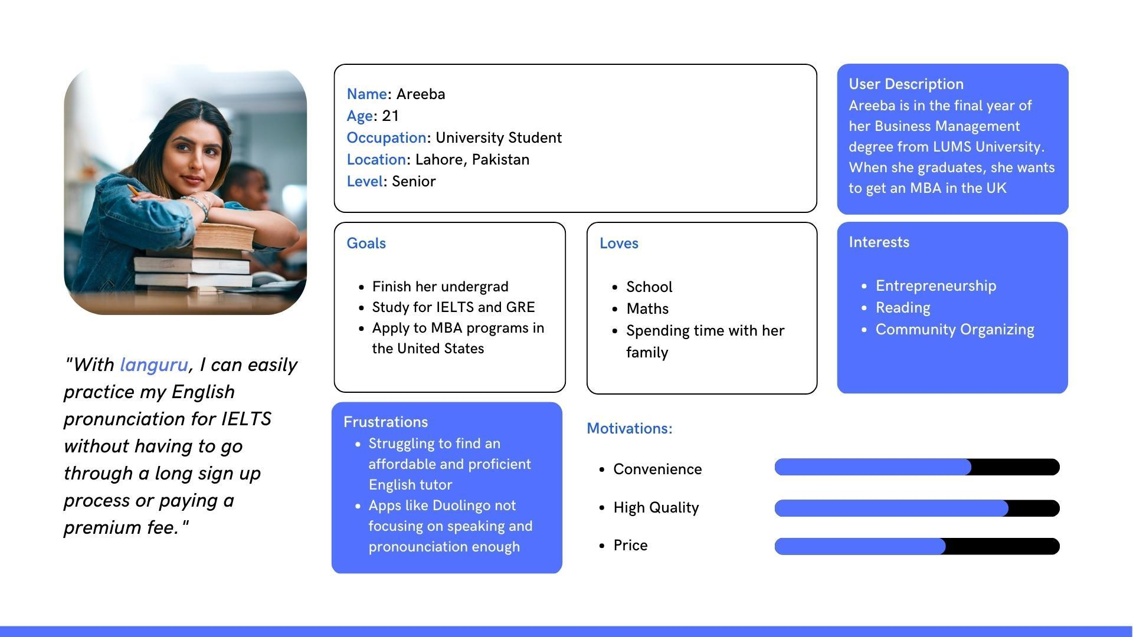
PERSONA 1

Slide 12
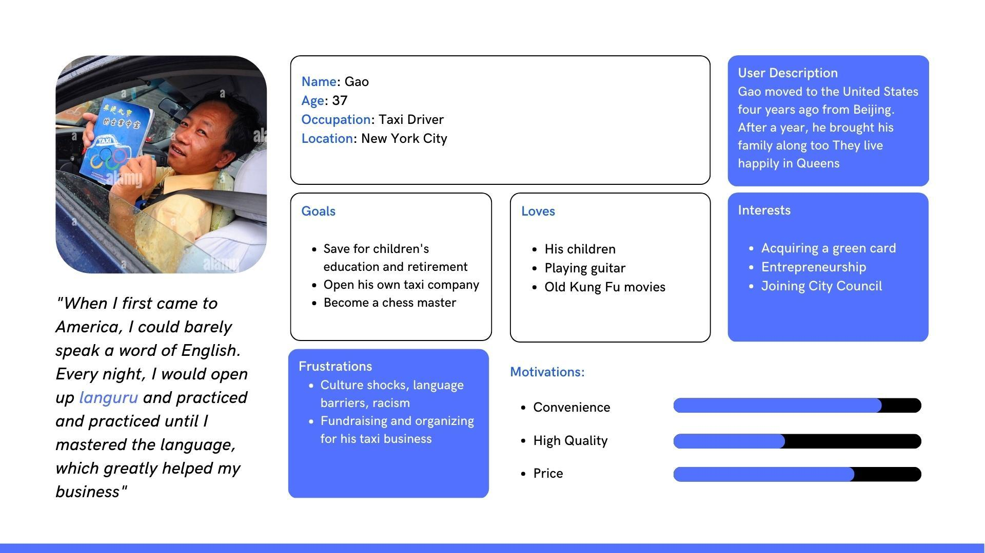
PERSONA 2

Slide 13
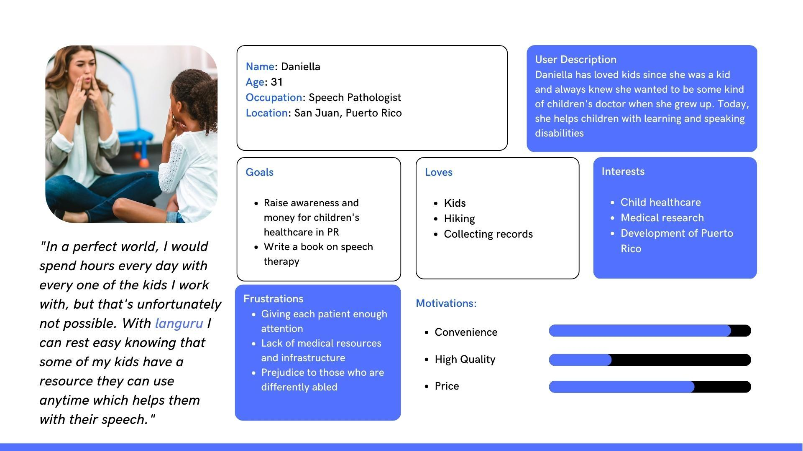
PERSONA 3

Slide 14
Minimum Viable Product
04

Slide 15
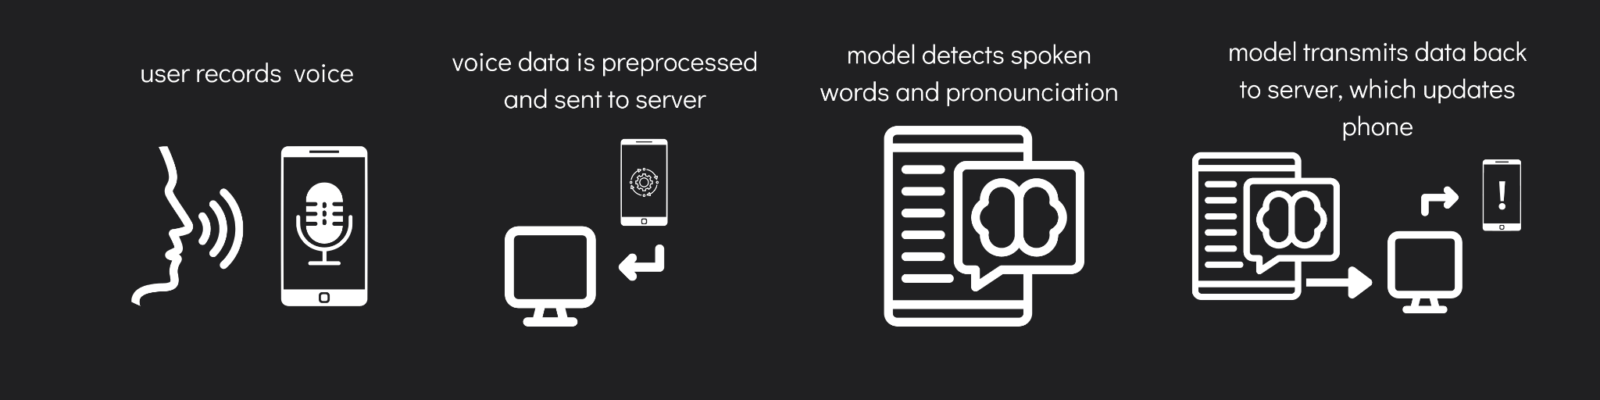
MINIMAL VIABLE PRODUCT (MVP)
Mobile application with speech recording capability
Machine learning algorithm/API to break down individual spoken words, detect, and note incorrect pronunciations
Server with functionality to receive voice data and send back analyzed data
Server to host machine learning model
Steps:

Slide 16

APP LOGO
The name of the app is a combination of Language and guru. Blue will be the main theme of the application.
Languru logo

Slide 17
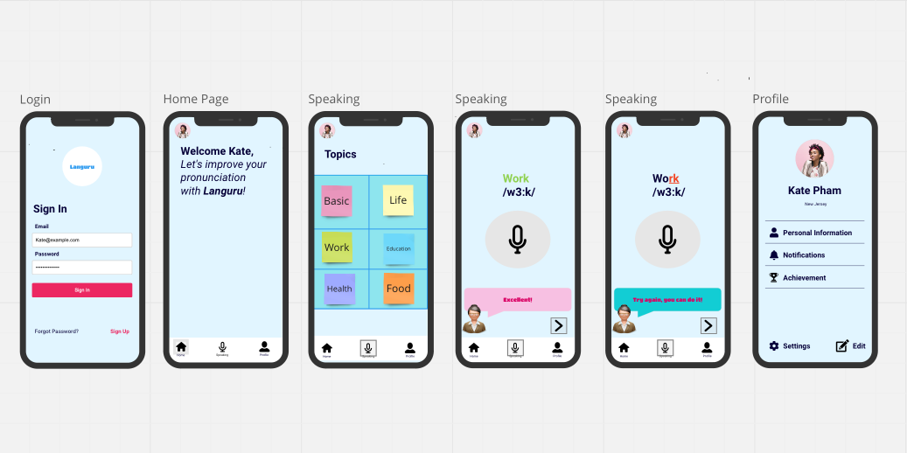
MOCK UP DESIGN

Slide 18
Technologies
05

Slide 19


Slide 20
06
ARCHITECTURE DESIGN

Slide 21
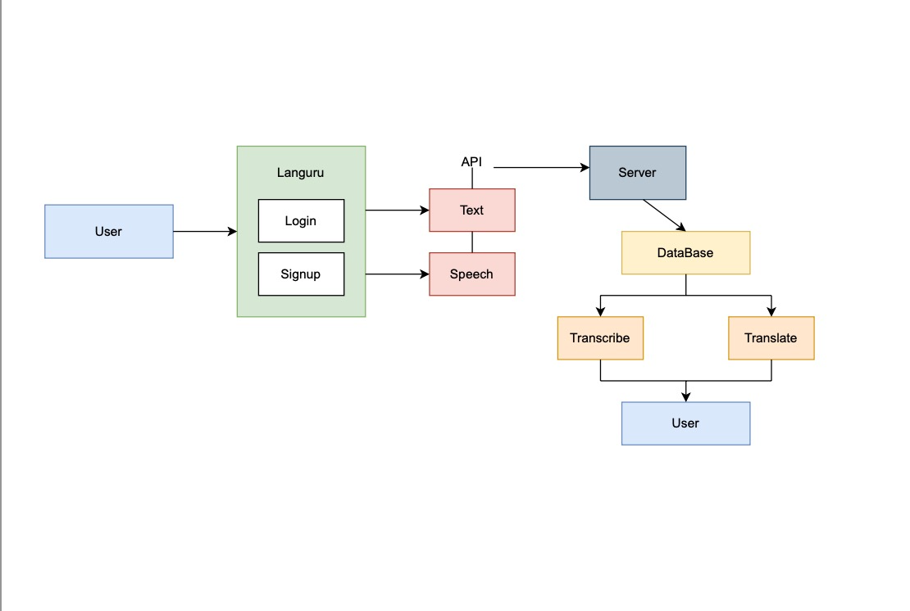
System Diagram

Slide 22
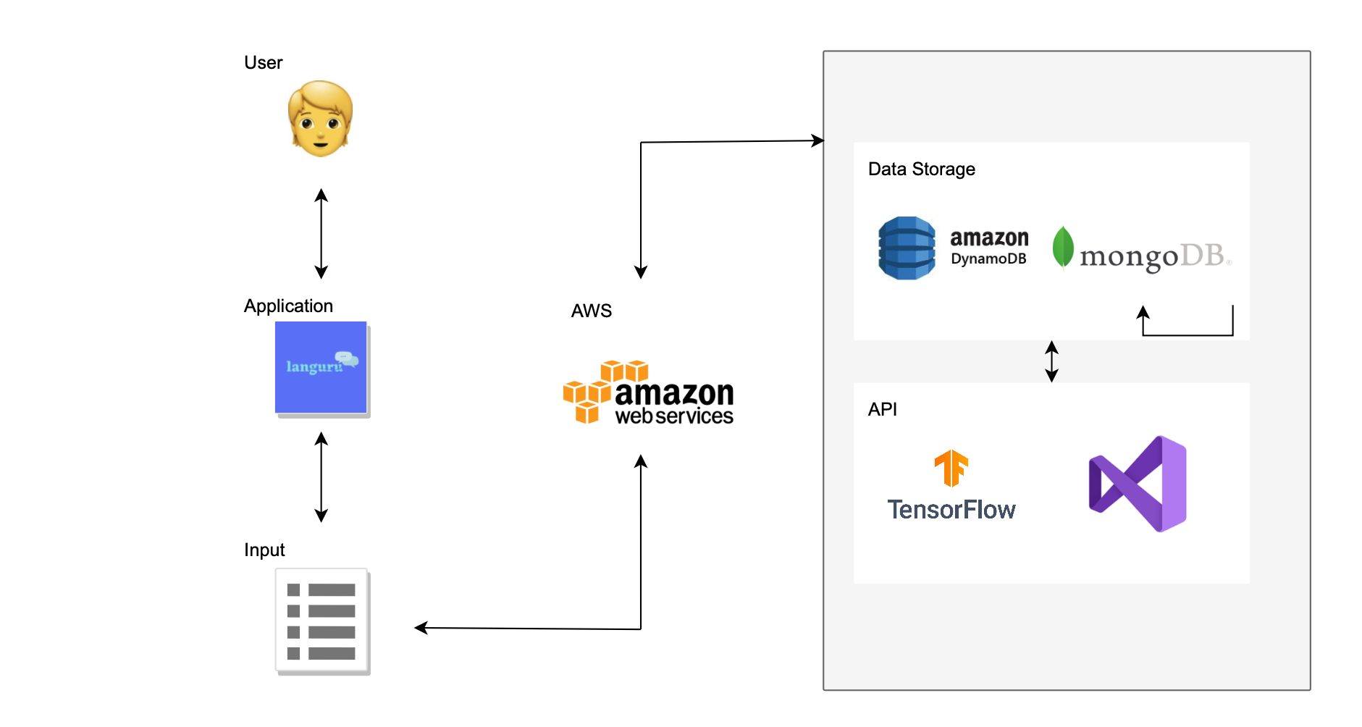
Conceptual Architecture Diagram

Slide 23
SEQUENCE DIAGRAM
User
Languru
Speech Recognition
Record Audio
Process Audio data
Analyze Speech Data
Return Feedback
Review Feedback

Slide 24
07
SPRINT 2 RECAP

Slide 25
SPRINT 2 - SPRINT 3
SPRINT 2
SAMPLE SENTENCE FOR PRACTICE
RECORD FUNCTION
PLAY BACK RECORD FUNCTION
SPRINT 3
LOGIN PAGE
SIGN UP
HOME PAGE
RECORD PAGE WITH SCORE FUNCTION
PROFILE PAGE BASIC
SETTING PAGE BASIC

Slide 26
08
PRODUCT BACKLOG

Slide 27
Issue Type | Key | Needs
Story | LNG-101 | As a user, I want to be able to choose a topic for pronunciation practice So that I can focus on specific areas of improvement.
Story | LNG-102 | As a user, I want to keep track of my progress in pronunciation and fluency So that I can see my improvement over time.
Story | LNG-103 | As a user, I want to receive scores and feedback on my pronunciation accuracy So that I can understand my strengths and areas for improvement.
Story | LNG-104 | As a user, I want to recover my account in case I forget my login credentials So that I can continue using the app without losing my progress.
Story | LNG-105 | As a user, I want to reset my password if I forget it So that I can regain access to my account and continue using the app.
Story | LNG-106 | As a user, I want to access and manage my personal settings So that I can customize my learning experience according to my preferences.
Story | LNG-107 | As a user, I want to be able to edit my personal information So that I can manage it.
Story | LNG-108 | As a user, I would like to have a navigation bar to switch from one page to another, login and logout for more convenient use.
Story | LNG-109 | As a user, I want to receive notifications for new exercises and updates So that I can stay engaged with the app and continue improving my English pronunciation and fluency.

Slide 28
SPRINT 3 BACKLOG
Issue type | Key | Name
Story | LNG-97 | As a user, I want to create a login and sign-up page to access the Languru app.
Story | LNG-98 | As a user, I want to create and edit my user profile, so that my preferences and progress are saved.
Story | LNG-88 | As a user, I want to see my score and receive feedback on my pronunciation and fluency.
Story | LNG-87 | As a user, I want to recover my account and reset my password if I forget it.
Task | LNG-89 | Draft Technical Paper

Slide 29
STORIES COMPLETED AND STORIES NOT COMPLETED
Name | Status | Date
As a user, I want to create a login and sign-up page to access the Languru app. | Done | 04/13/2023
As a user, I would like to have a navigation bar to switch from one page to another, login and logout for more convenient use. | Done | 04/16/2023
As a user, I want to create and edit my user profile, so that my preferences and progress are saved. | Done | 04/13/2023
As a user, I want to see my score and receive feedback on my pronunciation and fluency. | Done | 04/16/2023
As a user, I want to recover my account and reset my password if I forget it. | Done | 04/13/2023
As an user, I want to be able to choose a topic for pronunciation practice So that I can focus on specific areas of improvement. | Done | 04/16/2023
As an user, I want to receive scores on my pronunciation accuracy So that I can understand my strengths and areas for improvement. | Done | 04/16/2023
Draft Technical Paper | Done | 04/14/2023

Slide 30
STORIES
AND
ACCEPTANCE CRITERIA

Slide 31
User Story ID | Summary
1 | As an English language learner I want to receive real-time feedback on my pronunciation accuracy so that I can improve my speaking skills and sound more fluent.
 | Scenario: User is looking for feedback for their speaking Given I'm in a role of user who bad at pronounce in English Then Languru can give feedback
2 | As an English language learner I want to Practice speaking English using different words and phrases so that I can expand my vocabulary and improve my pronunciation skills
 | Scenario: User want to practice on different topics Given I'm in the role of user When I'm click on Speaking page Then a list of topics show up for user to choose
3 | As an English language learner I want to Receive personalized recommendations for pronunciation practice based on my weaknesses so that I can focus on improving areas where I need the most help.
 | Scenario: User have trouble cannot improve their speaking after many tries with the same word Given I'm a role of user When many try, the system recommend a personalized lesson

Slide 32
User Story ID | Summary
4 | As an English language learner I want to Track my progress and see improvement over time so that I can stay motivated and feel a sense of accomplishment.
 | Scenario: User want to keep track of their progress Given I'm in the role of user When open the app, click on profile, I can see our progress and achievements.
5 | As an English language learner I want to Practice my pronunciation in different contexts, such as in a business setting or social setting so that I can prepare for real-life situations where I need to speak English
 | Scenario: User want to improve speaking through different conversation Given I'm in the role of user When i search on search box the specific context Then desired outcome should show up

Slide 33
TEST CASES

Slide 34
TEST CASE ID | TEST SCENARIO | TEST CASE | PRE-CONDITION | TEST STEPS | TEST DATA | EXPECTED RESULT | ACTUAL RESULT | STATUS (PASS/ FAIL)
TC_LOGIN_1 | Verify the login of email | Enter valid User Name and valid Password | 1. Need a valid email Account to do login | 1. Enter User Name | <Valid User Name> | Login Successful | Login Successful | PASS
 |  |  |  | 2. Enter Password | <Valid Password>
 |  |  |  | 3. Click "Login" button
TC_LOGIN_1 | Verify the login of email | Enter valid User Name and invalid Password | 1. Need a valid email Account to do login | 1. Enter User Name | <Valid User Name> | A message "The email or password you entered don't match" is shown | A message "The email or password you entered don't match" is shown | PASS
 |  |  |  | 2. Enter Password | <Invalid Password>
 |  |  |  | 3. Click "Login" button
TC_LOGIN_1 | Verify the login of email | Enter invalid User Name and valid Password | 1. Need a valid email Account to do login | 1. Enter User Name | <Invalid User Name> | A message "The email or password you entered don't match" is shown | A message "The email or password you entered don't match" is shown | PASS
 |  |  |  | 2. Enter Password | <Valid Password>
 |  |  |  | 3. Click "Login" button
TC_LOGIN_1 | Verify the login of email | Enter invalid User Name and invalid Password | 1. Need a valid email Account to do login | 1. Enter User Name | <Invalid User Name> | A message "The email or password you entered don't match" is shown | A message "The email or password you entered don't match" is shown | PASS
 |  |  |  | 2. Enter Password | <Invalid Password>
 |  |  |  | 3. Click "Login" button

Slide 35
TEST CASE ID | TEST SCENARIO | TEST CASE | PRE-CONDITION | TEST STEPS | TEST DATA | EXPECTED RESULT | ACTUAL RESULT | STATUS (PASS/ FAIL)
TC_SIGNUP_2 | Verify sign up | Enter valid User Name and valid Password | 1. Need a valid user name and password (characters and number from1 to 9) to sign up | 1. Enter User Name | <Valid User Name> | Sign up Successful | Sign up Successful | PASS
 |  |  |  | 2. Enter Password | <Valid Password>
 |  |  |  | 3. Click "signup" button
TC_SIGNUP_2 | Verify sign up | Enter used User Name | 1. Need a valid user name and password (characters and number from1 to 9) to sign up | 1. Enter User Name | <used Username > | A message "The user name is already used" is shown | A message "The user name is already used" is shown | PASS
 |  |  |  | 2. Enter Password
 |  |  |  | 3. Click "signup" button
TC_SIGNUP_2 | Verify sign up | Enter invalid User Name and invalid Password | 1. Need a valid user name and password (characters and number from1 to 9) to sign up | 1. Enter User Name | <Invalid Password> | A message "password don't match our requires" is shown | A message "password don't match our requires" is shown | PASS
 |  |  |  | 2. Enter Password
 |  |  |  | 3. Click "signup" button

Slide 36
TEST CASE ID | TEST SCENARIO | TEST CASE | TEST STEPS | TEST DATA | EXPECTED RESULT | ACTUAL RESULT | STATUS (PASS/ FAIL)
TC_HOMEPAGE_3 | Verify the HOME PAGE | A welcome message should show up on screen |  |  | Check if a welcome message appear on the home screen |  | PASS
 | Verify the HOME PAGE
TC_HOMEPAGE_3 |  | User should be able to search from homepage |  |  | Homepage can show expected results.
TC_HOMEPAGE_3 | Verify the HOME PAGE | User should be able to open the home page |  |  | Homepage should appear when user click on it. |  | PASS

Slide 37
TEST CASE ID | TEST SCENARIO | TEST CASE | PRE-CONDITION | TEST STEPS | TEST DATA | EXPECTED RESULT | ACTUAL RESULT | STATUS (PASS/ FAIL)
TC_FGPASS_6 | Check on Forgot Password | Should direct to the email in order to change password. |  |  |  | Password resetted and send back to login page. |  | PASS

Slide 38
TEST CASE ID | TEST SCENARIO | TEST CASE | PRE-CONDITION | TEST STEPS | TEST DATA | EXPECTED RESULT | ACTUAL RESULT | STATUS (PASS/ FAIL)
TC_PROFILE_4 | Check on Profile editable |  |  |  |  | Users can existing profile information successfully.
TC_PROFILE_4 | Check on features in Profile page |  |  |  |  | On the Profile page, users should be able to see list of features

Slide 39
TEST CASE ID | TEST SCENARIO | TEST CASE | PRE-CONDITION | TEST STEPS | TEST DATA | EXPECTED RESULT | ACTUAL RESULT | STATUS (PASS/ FAIL)
TC_SPEAKING_5 | Verify the speaking page | User should be able to record their voice |  |  |  | Record voice sucessfully |  | PASS
TC_SPEAKING_5 | Verify the speaking page | User should be able to see their feedback after they recorded their voice. |  |  |  | The score will show up after voice was recorded. |  | PASS
TC_SPEAKING_5 | Verify the speaking page | User should be able to see the topics that they want to practice and open it |  |  |  | The topics category will show up as expected. |  | PASS
TC_SPEAKING_5 | Verify the speaking page | User should be able to see where was pronounce incorrectly. |  |  |  | User can see the part was pronounce incorrect which is underlined.
TC_SPEAKING_5 | Verify the speaking page | User should be able to access the Speaking page |  |  |  | User can see the part was pronounce incorrect which is underlined.

Slide 40
METRICS
09

Slide 41
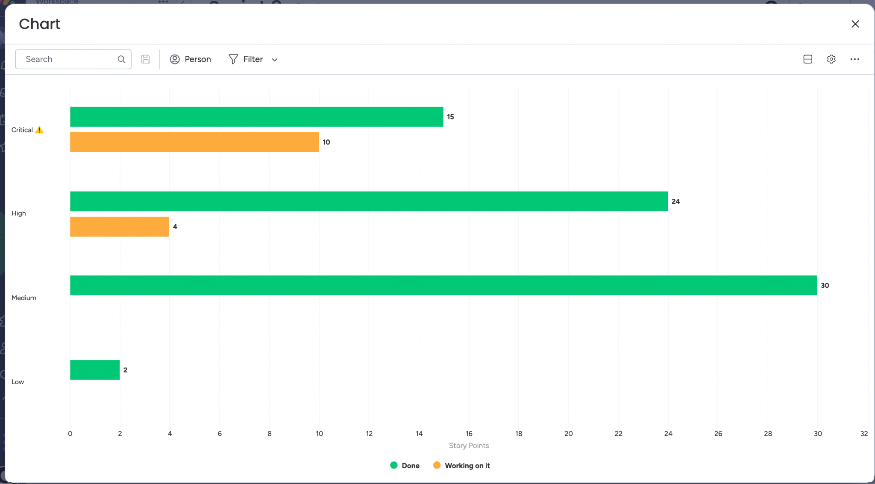
TEAM
HISTORY
VELOCITY

Slide 42
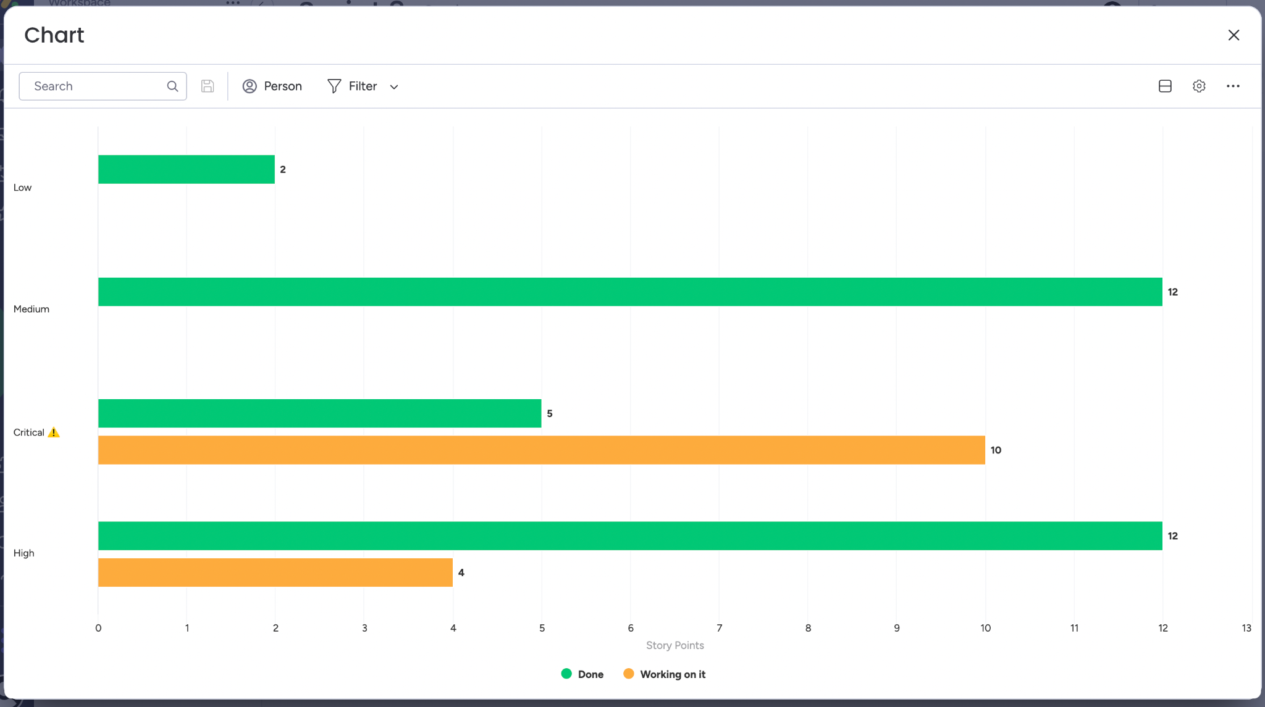
TEAM
Burndown
Chart

Slide 43
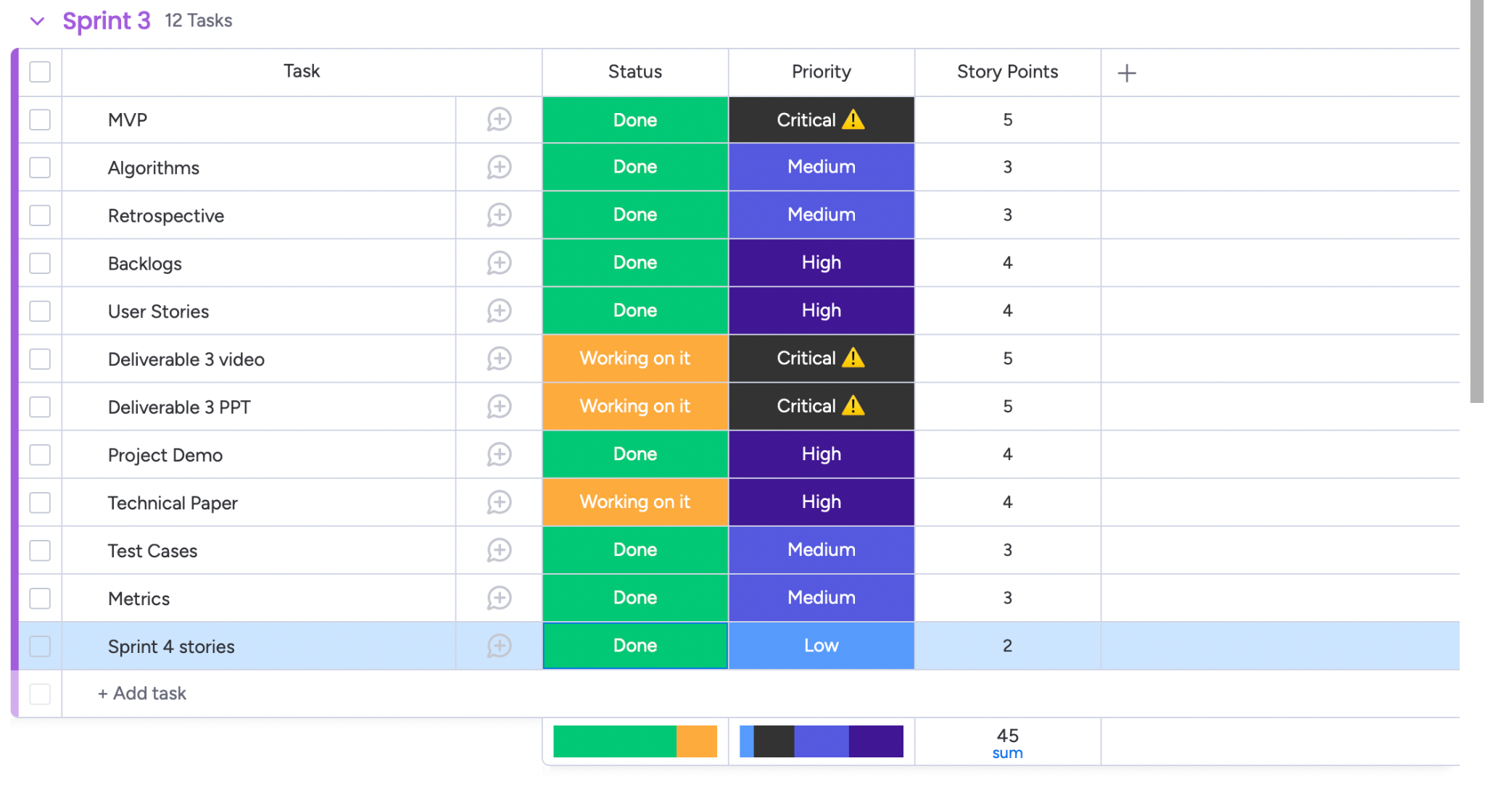
Completed tasks

Slide 44
RETROSPECTIVE
10

Slide 45
RETROSPECTIVE
WHAT WENT WELL
NEXT STEPS
WHAT NEEDS TO IMPROVE
We successfully add more functionality to our application and it worked perfectly.
- Meet more often to track the progress of each team member to avoid delays.
- Develop more functionality for our application.
- Work on technical paper.
Commitment among team members should be stronger. There have been a lot of late submissions of team members in this sprint. This was lead to the whole process delayed.

Slide 46
SPRINT 4
11

Slide 47
Stories planned and committed for Sprint 4
Issue Type | Key | Name | Status | Story Point Estimate
Story | LNG-102 | As an user, I want to keep track of my progress in pronunciation and fluency So that I can see my improvement over time. | To do | 3
Story | LNG-112 | As an user, I want to receive feedback on what part from my pronunciation incorrect So that I can understand my strengths and areas for improvement. | To do | 5
Story | LNG-107 | As a user, I want to be able to edit my personal information So that I can manage it. | To do | 3
Task | LNG-89 | Finish Technical Paper | To do | 8

Slide 48
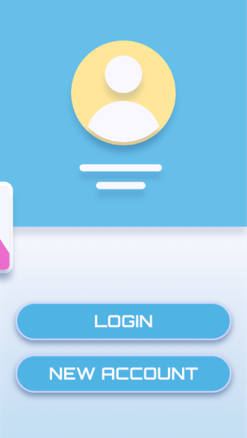
PRODUCT DEMO (SPRINT 3)
12

Slide 49
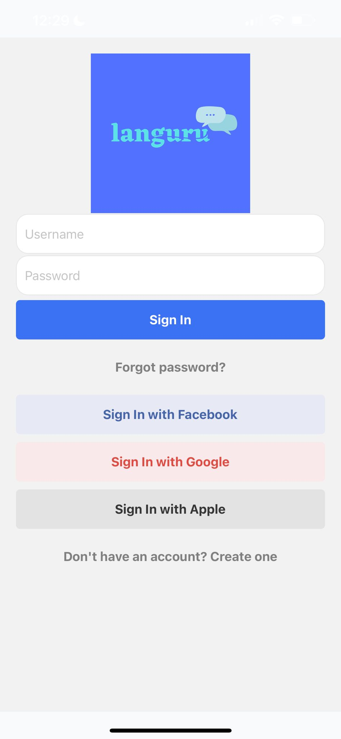
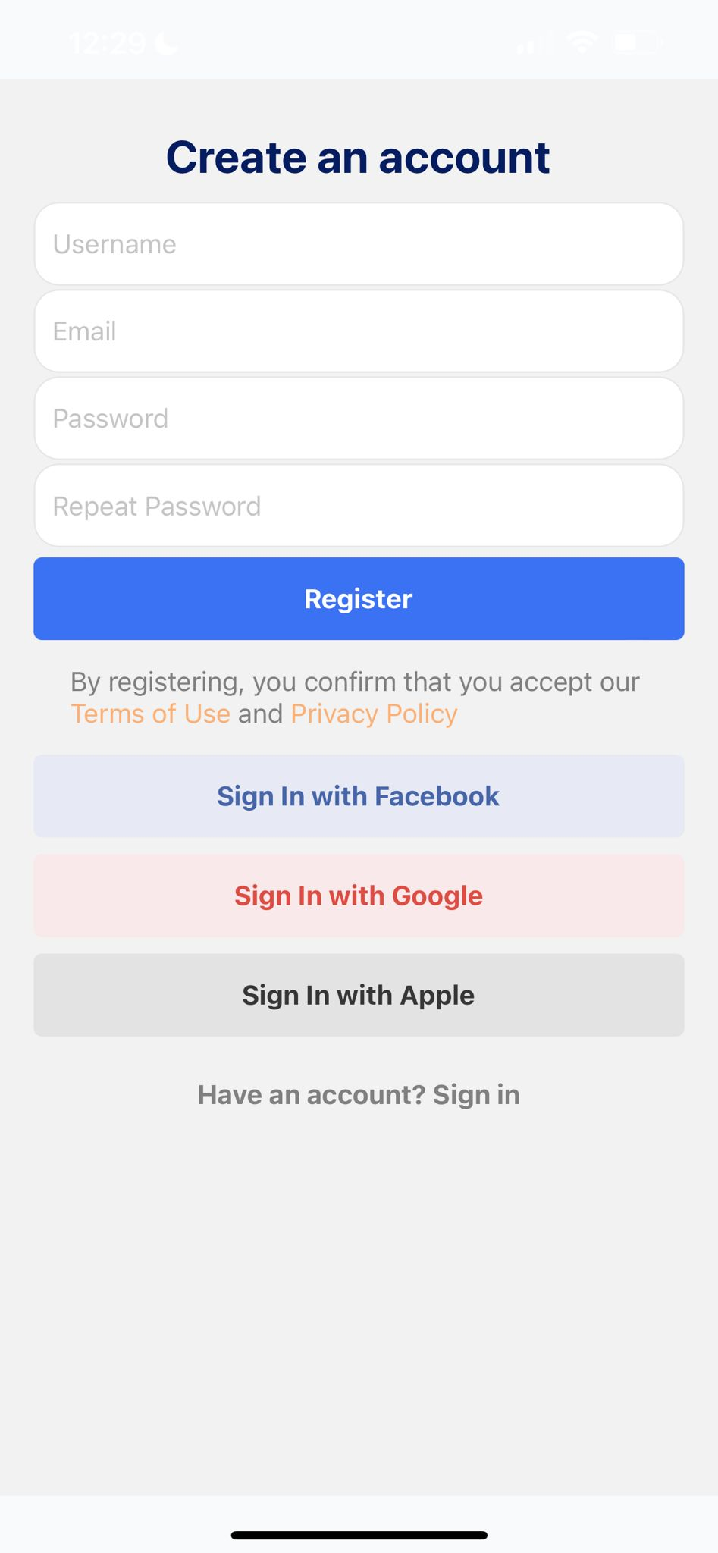
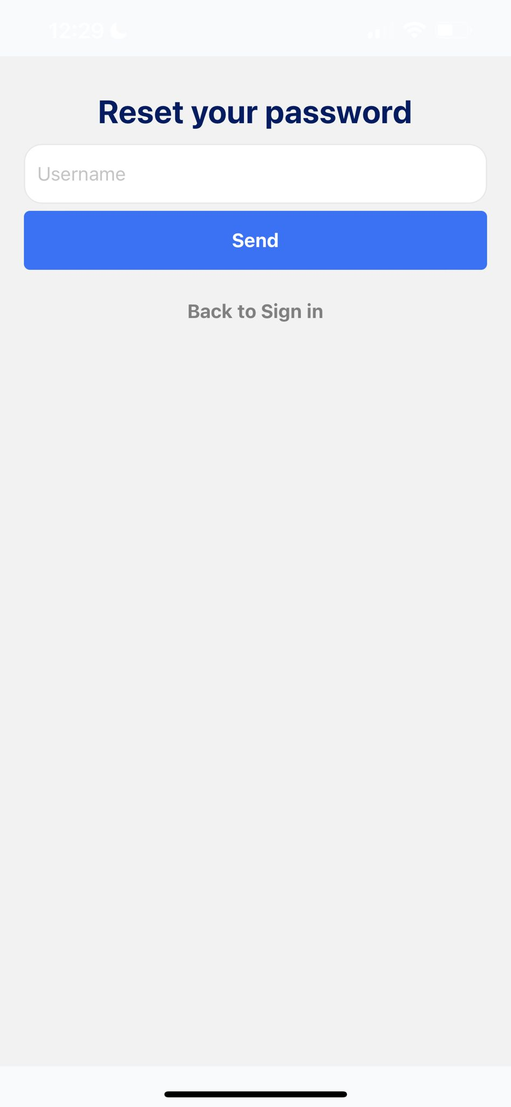
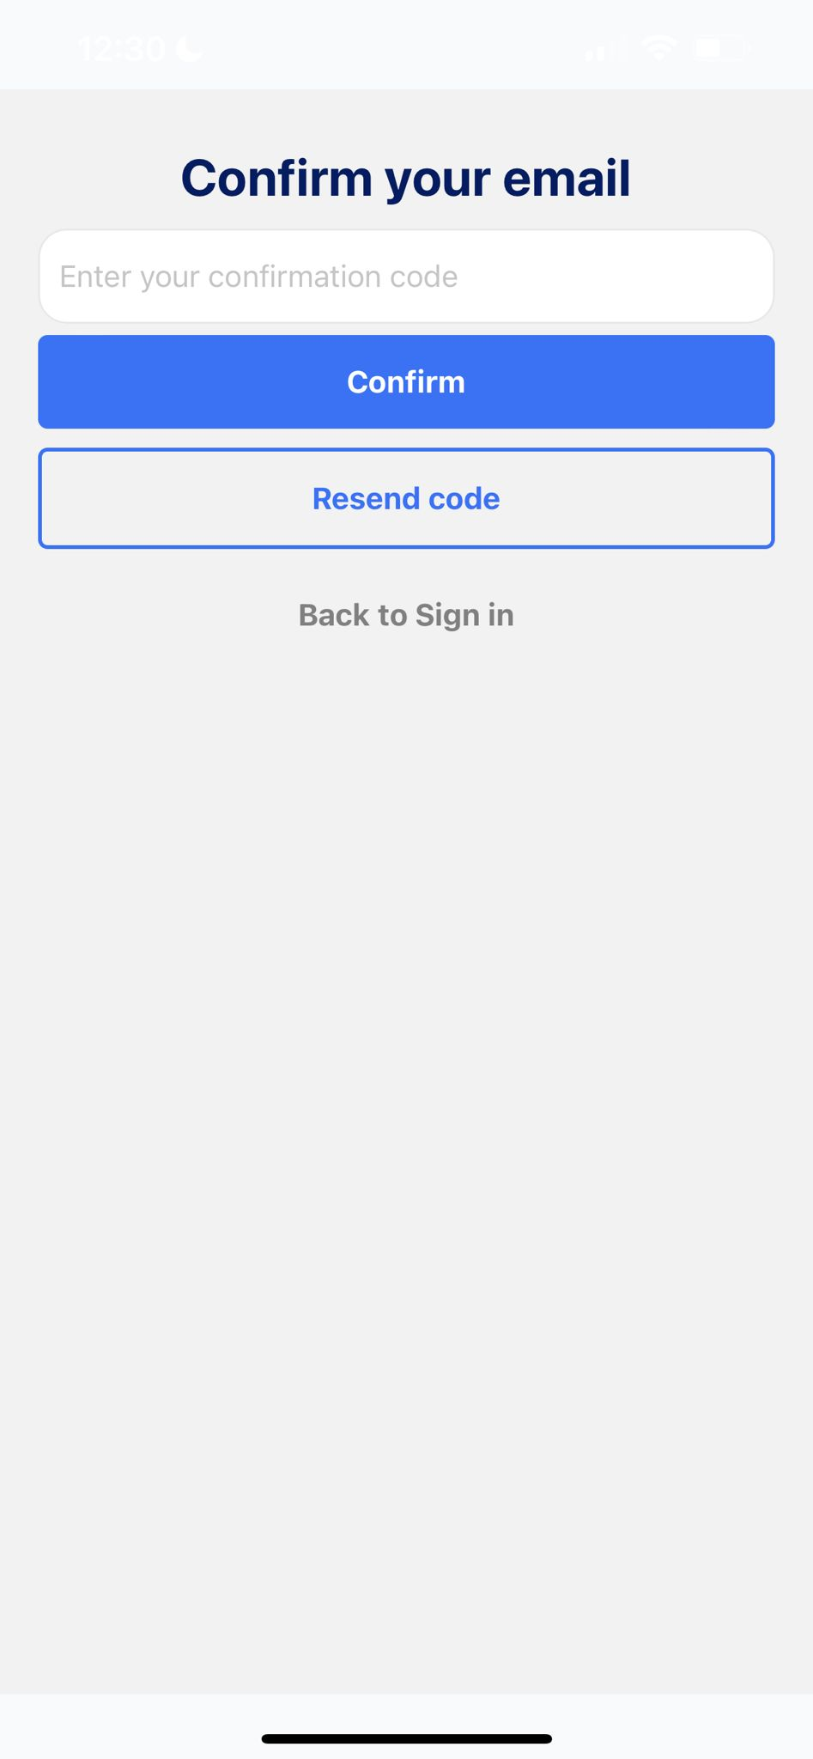
APP SCREENSHOTS
Sign in page
Sign up page
Forgot password
After register

Slide 50
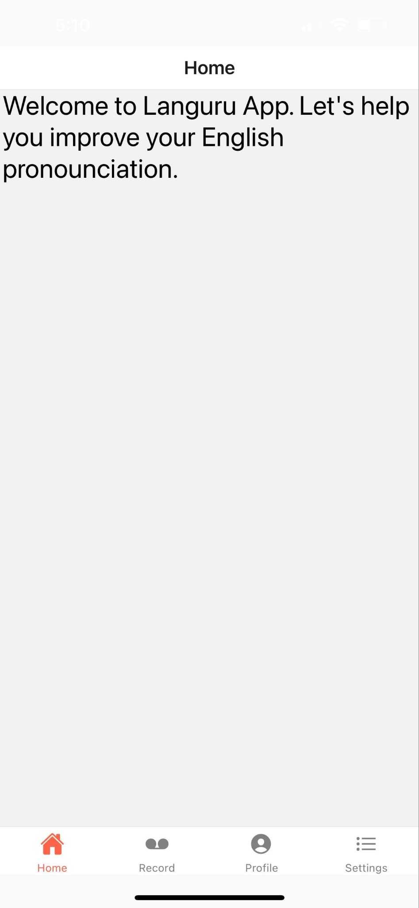
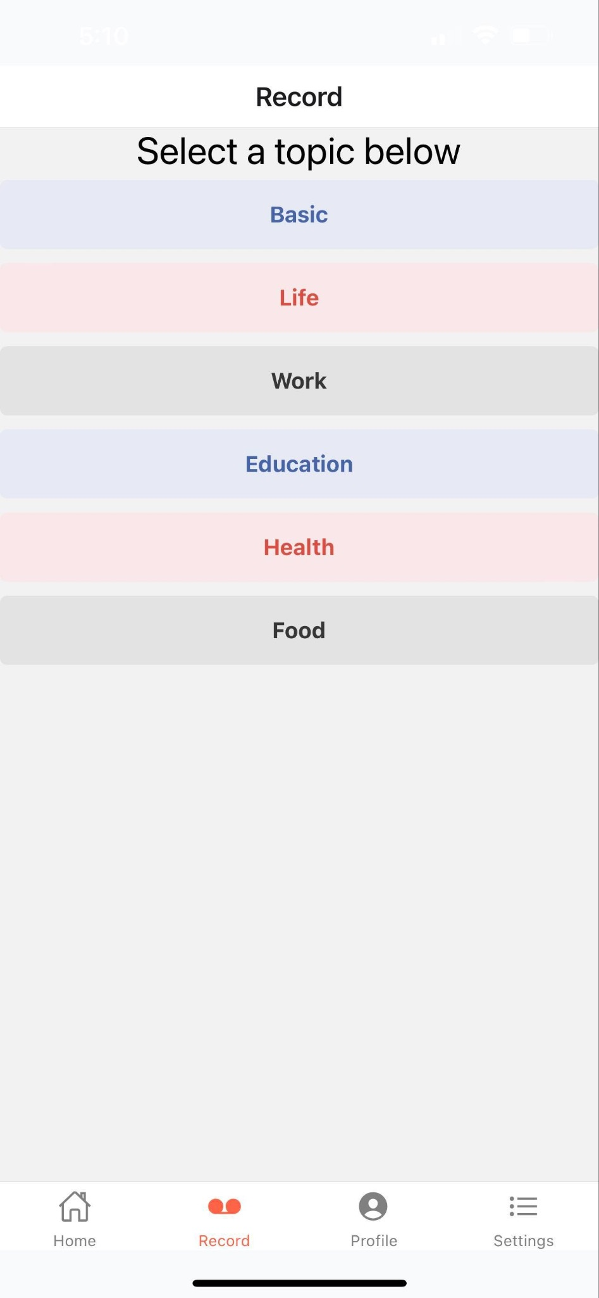
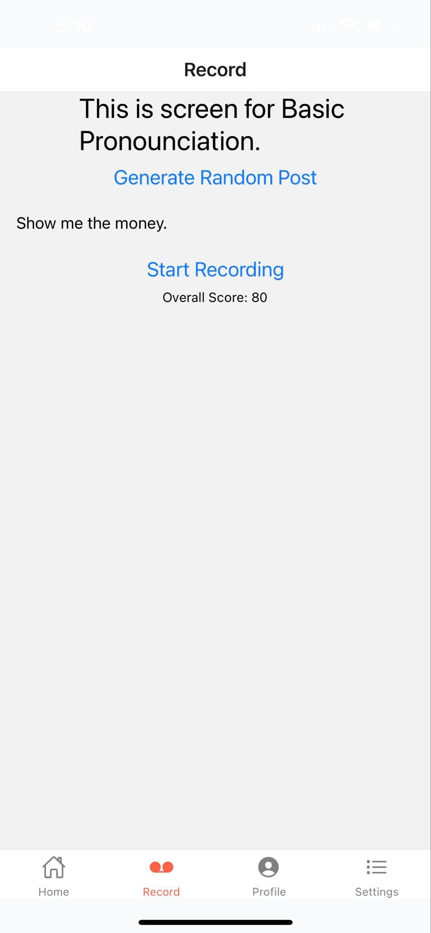
APP SCREENSHOTS
Home page
Record page 1
Record page 2

Slide 51
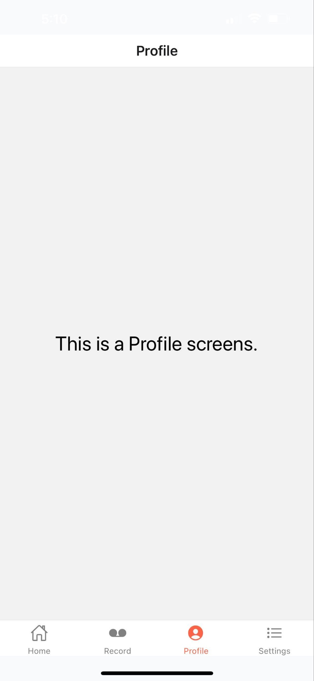
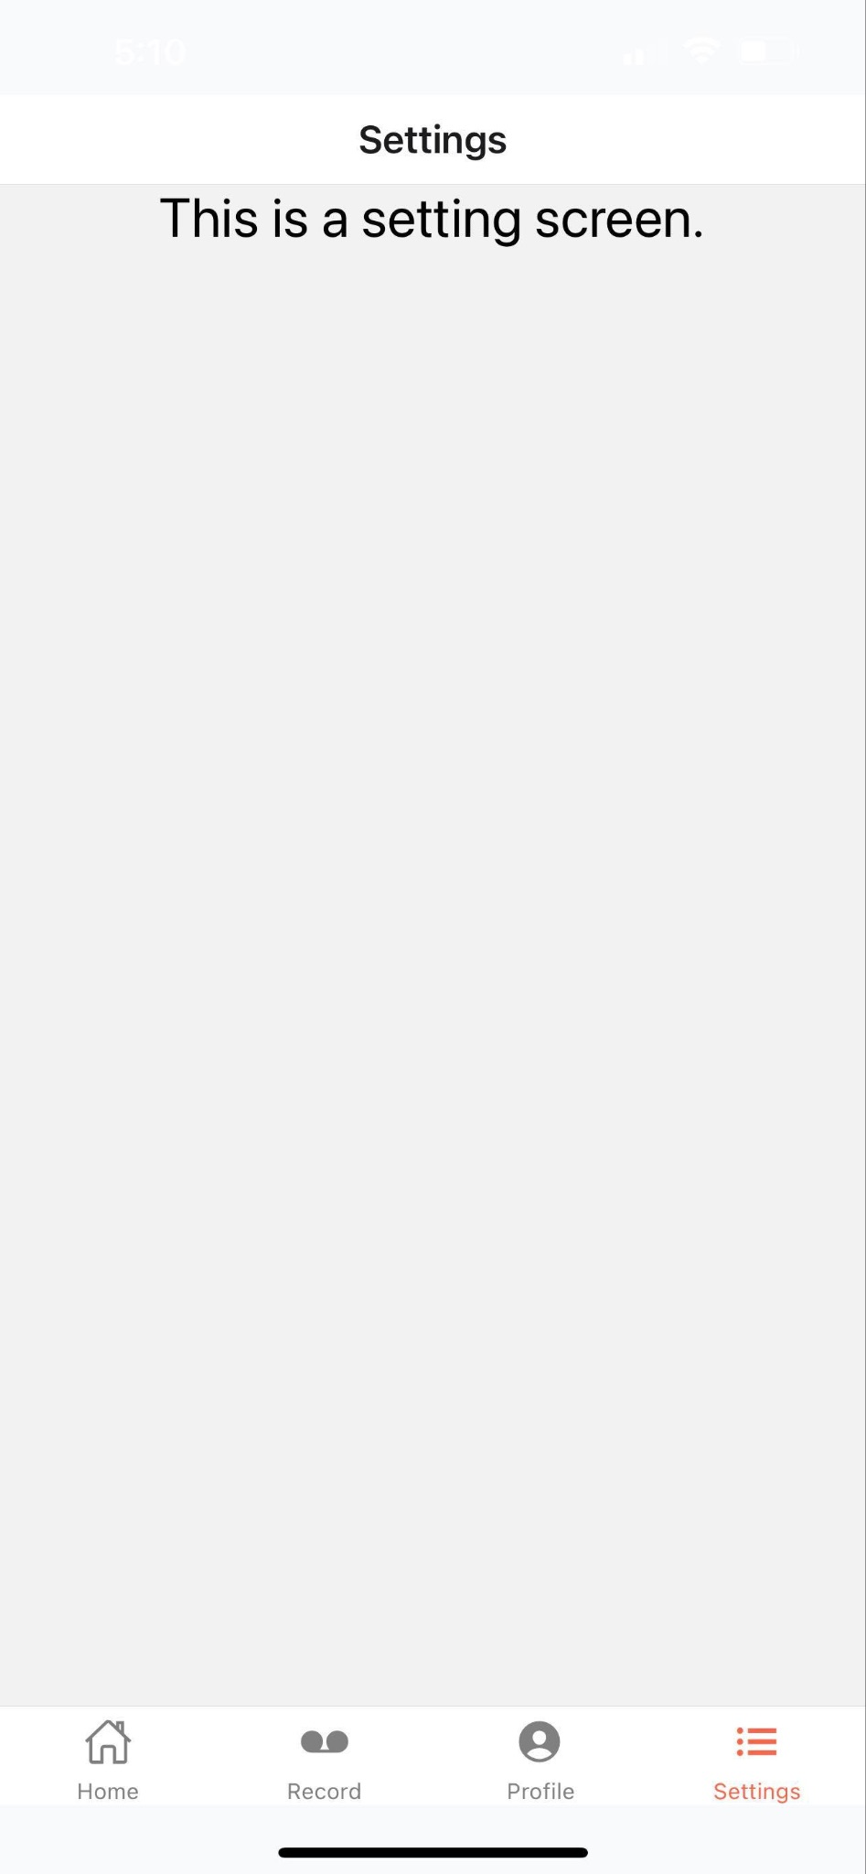
APP SCREENSHOTS
Profile page
Setting page

Slide 52
LIVE APPLICATION DEMO
13

Slide 53
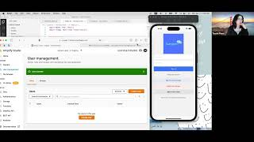

Slide 54
GITHUB LINK:
https://github.com/htmw/Languru/wiki
TECHNICAL PAPER LINK: https://github.com/htmw/Languru/blob/main/documentation/Deliverable3/CS691%20-%20Radiant%20Team%20Technical%20paper.pdf

Slide 55
TEAM 5 - RADIANTS
THANK YOU FOR WATCHING!

